Slide 1
Chapter 8
Fundamental Sampling Distributions and Data Descriptions

Slide 2
Section 8.1
Random Sampling

Slide 3
Definition 8.1

Slide 4
Definition 8.2

Slide 5
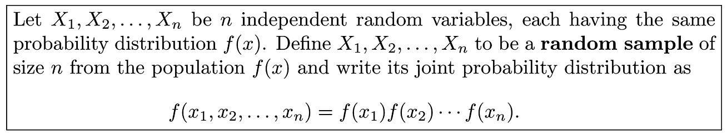
Definition 8.3

Slide 6
Section 8.2
Some Important Statistics

Slide 7
Definition 8.4

Slide 8
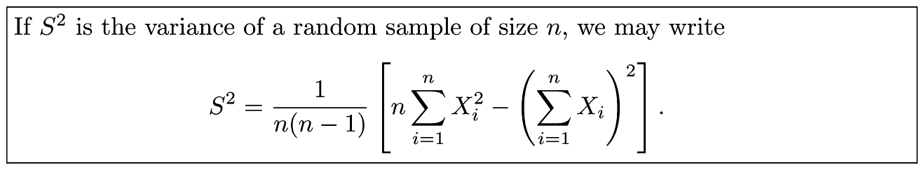
Theorem 8.1

Slide 9
Section 8.3
Sampling Distributions

Slide 10
Definition 8.5

Slide 11
Section 8.4
Sampling Distribution of Means and the Central Limit Theorem

Slide 12
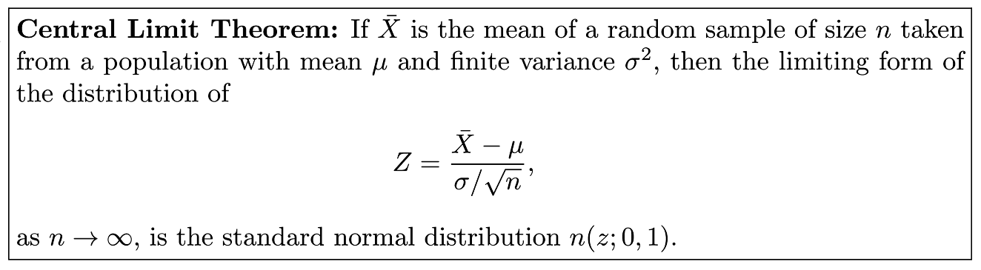
Theorem 8.2

Slide 13
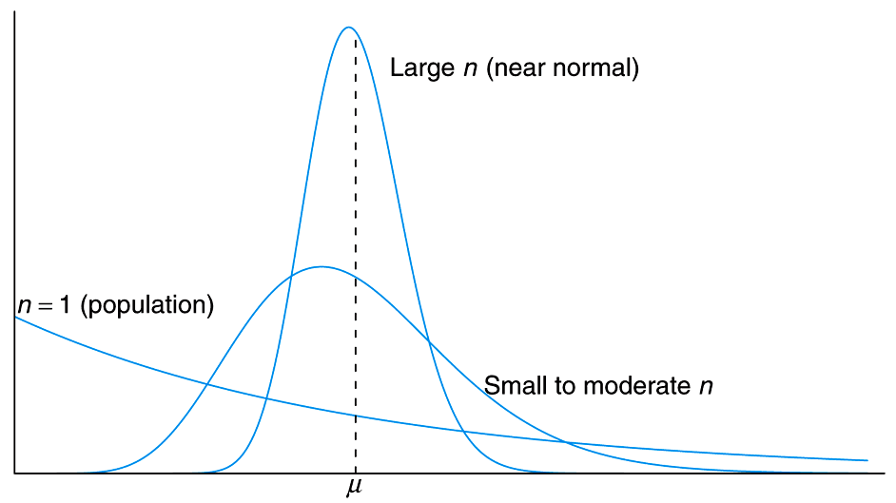
Figure 8.1 Illustration of the Central Limit Theorem (distribution of X for n = 1, moderate n, and large n)
_

Slide 14
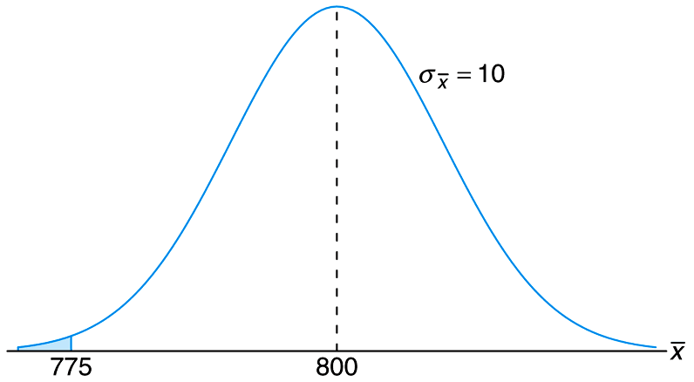
Figure 8.2 Area for Example 8.4

Slide 15
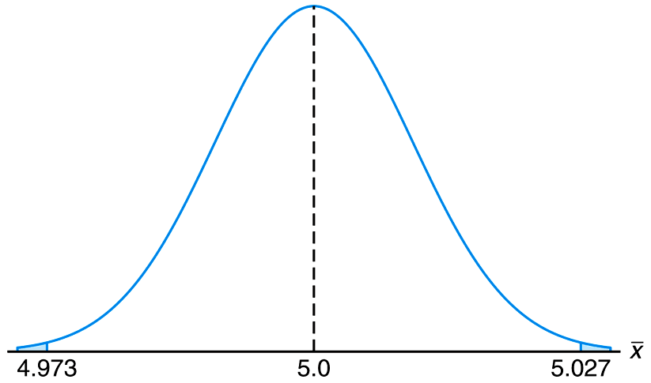
Figure 8.3 Area for Case Study 8.1

Slide 16
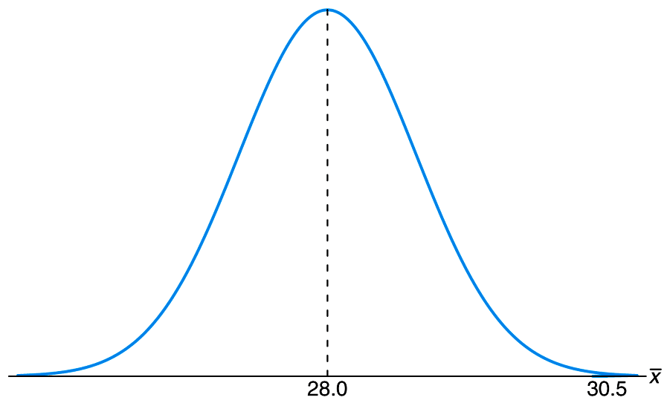
Figure 8.4 Area for Example 8.5

Slide 17
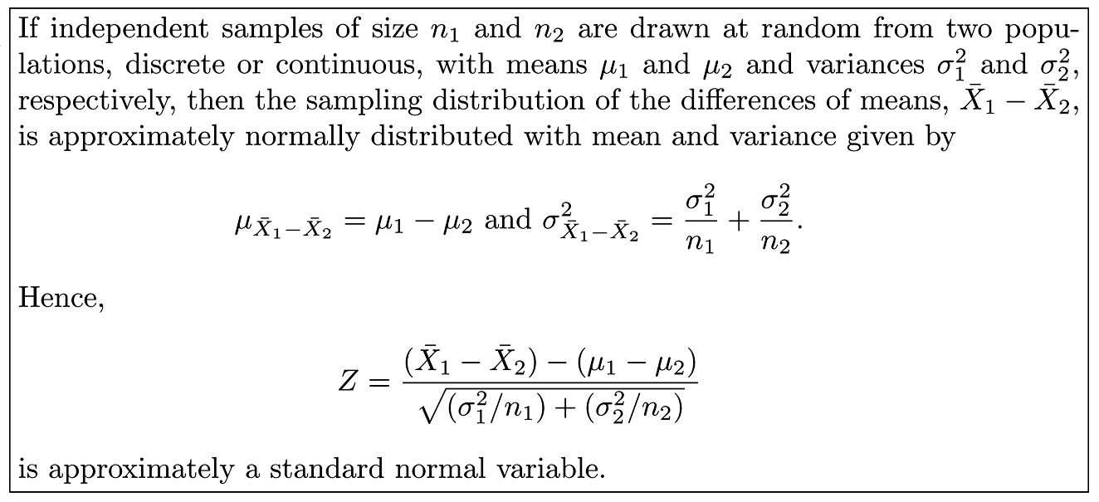
Theorem 8.3

Slide 18
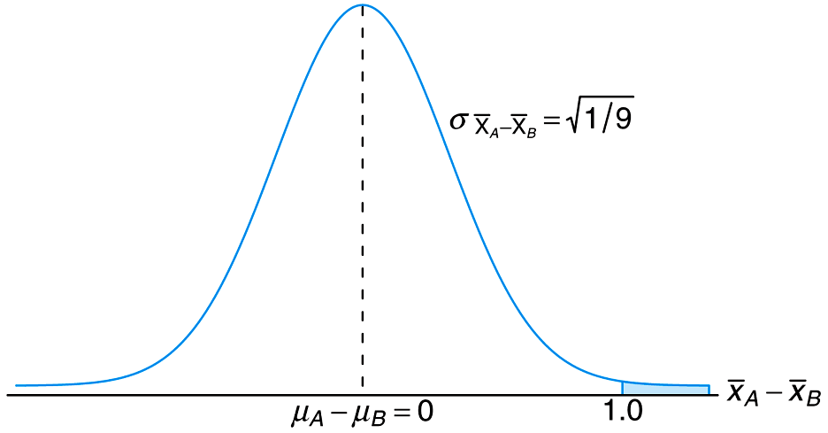
Figure 8.5 Area for Case Study 8.2

Slide 19
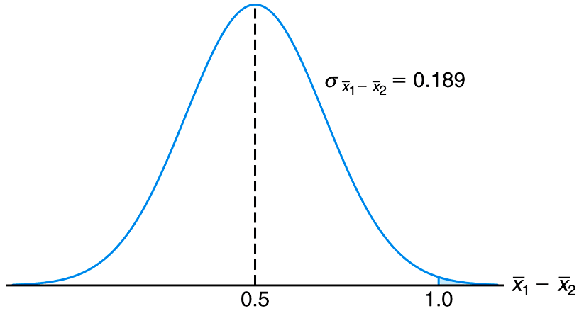
Figure 8.6 Area for Example 8.6

Slide 20
Section 8.5
Sampling Distribution of S²

Slide 21
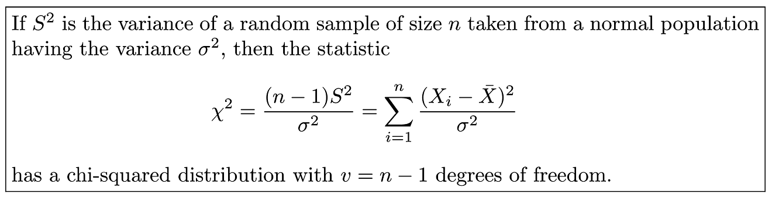
Theorem 8.4

Slide 22
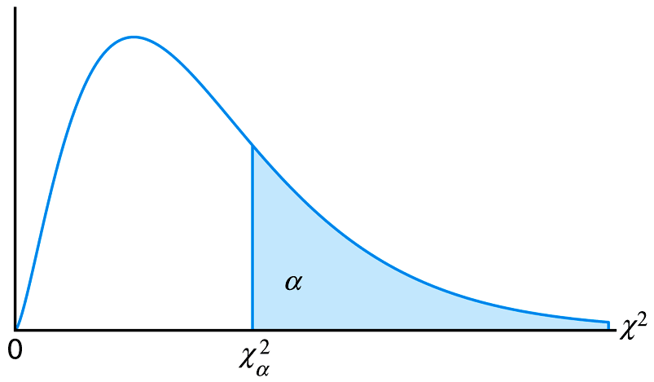
Figure 8.7 The chi-squared distribution

Slide 23
Section 8.6
t-Distribution

Slide 24
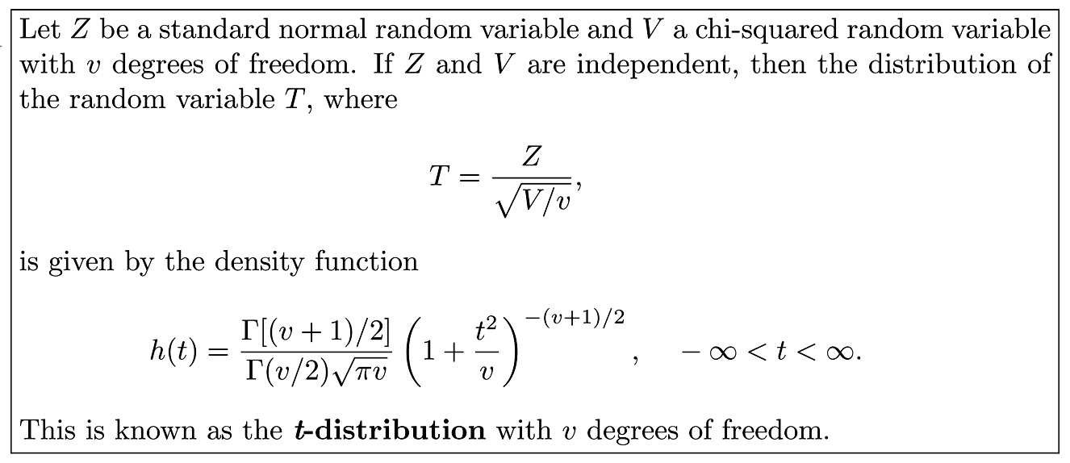
Theorem 8.5

Slide 25
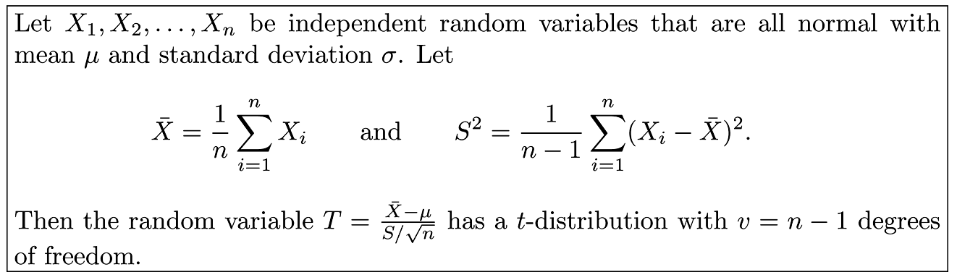
Corollary 8.1

Slide 26

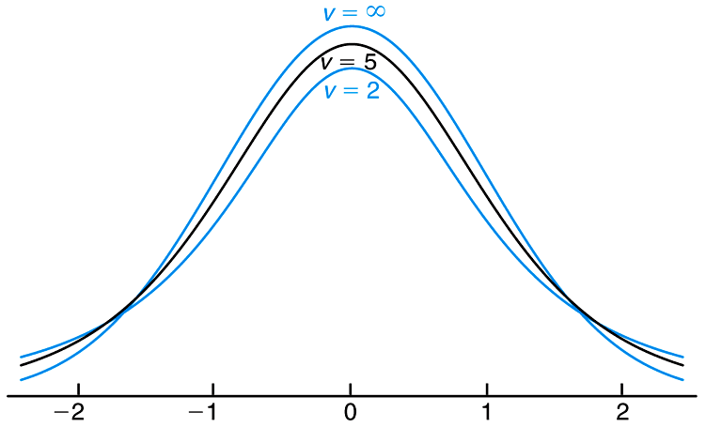
Figure 8.8 The t-distribution curves for v = 2, 5, and

Slide 27
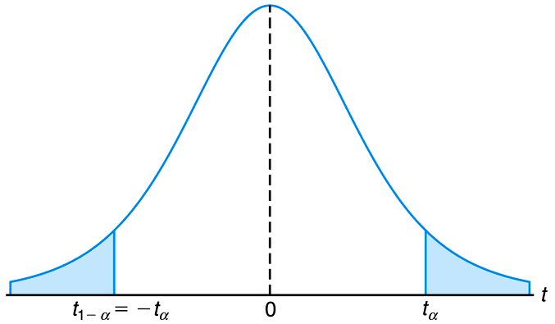
Figure 8.9 Symmetry property (about 0) of the t-distribution

Slide 28
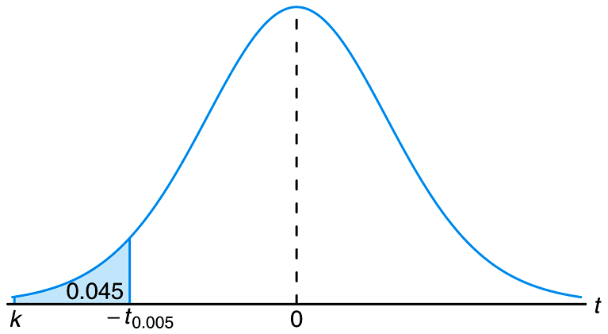
Figure 8.10 The t-values for Example 8.10

Slide 29
Section 8.7
F-Distribution

Slide 30
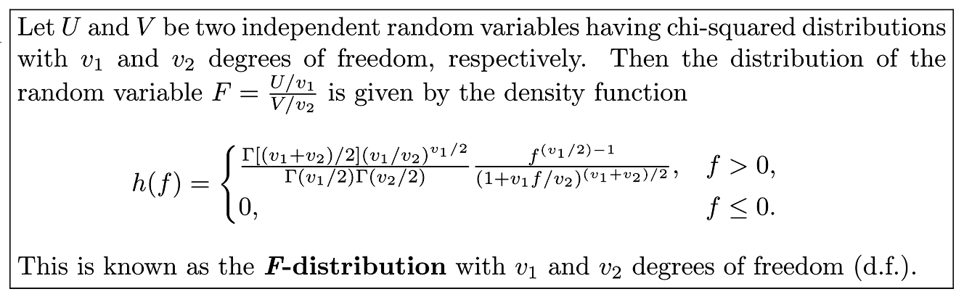
Theorem 8.6

Slide 31
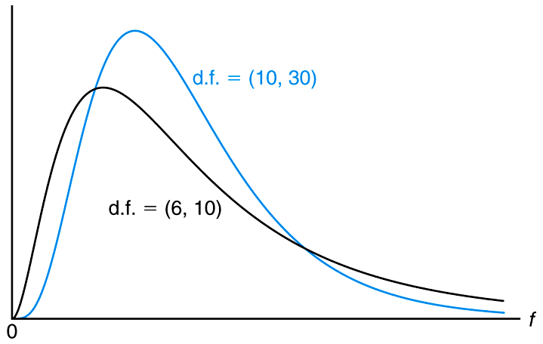
Figure 8.11 Typical F-distributions

Slide 32
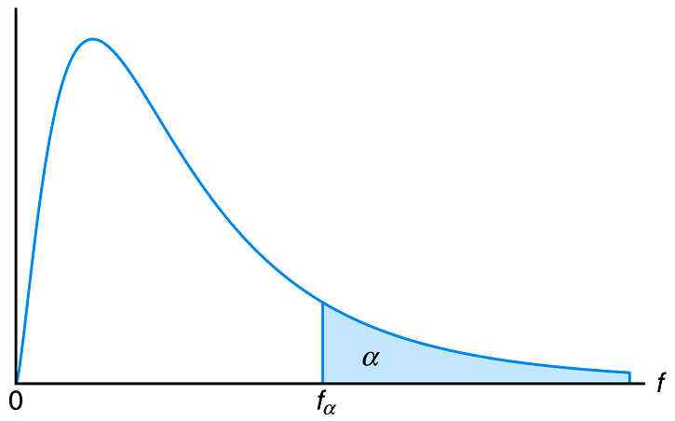
Figure 8.12 Illustration of the f_{α} for the F-distribution

Slide 33
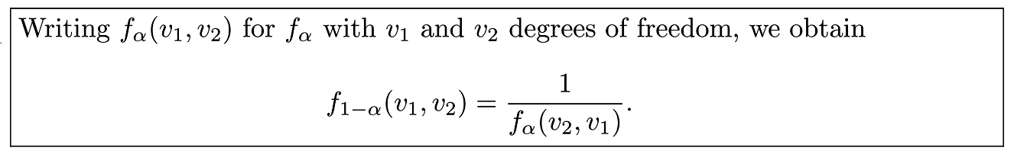
Theorem 8.7

Slide 34
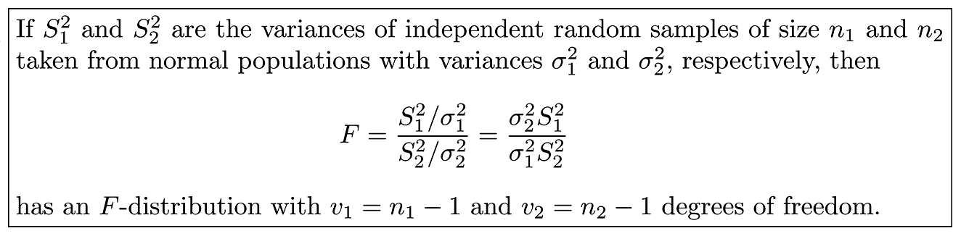
Theorem 8.8

Slide 35
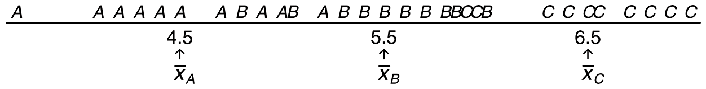
Figure 8.13 Data from three distinct samples

Slide 36
Figure 8.14 Data that easily could have come from the same population

Slide 37
Section 8.8
Quantile and Probability Plots

Slide 38
Definition 8.6

Slide 39
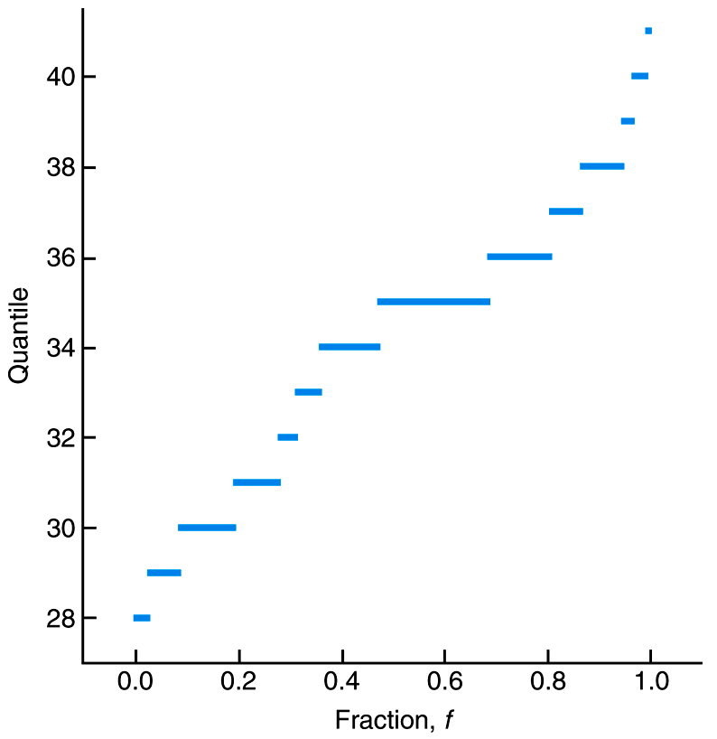
Figure 8.15 Quantile plot for paint data

Slide 40
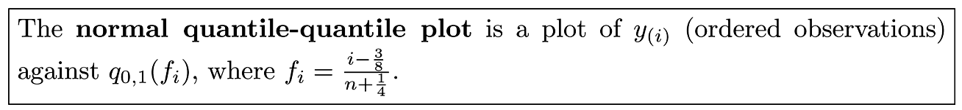
Definition 8.7

Slide 41
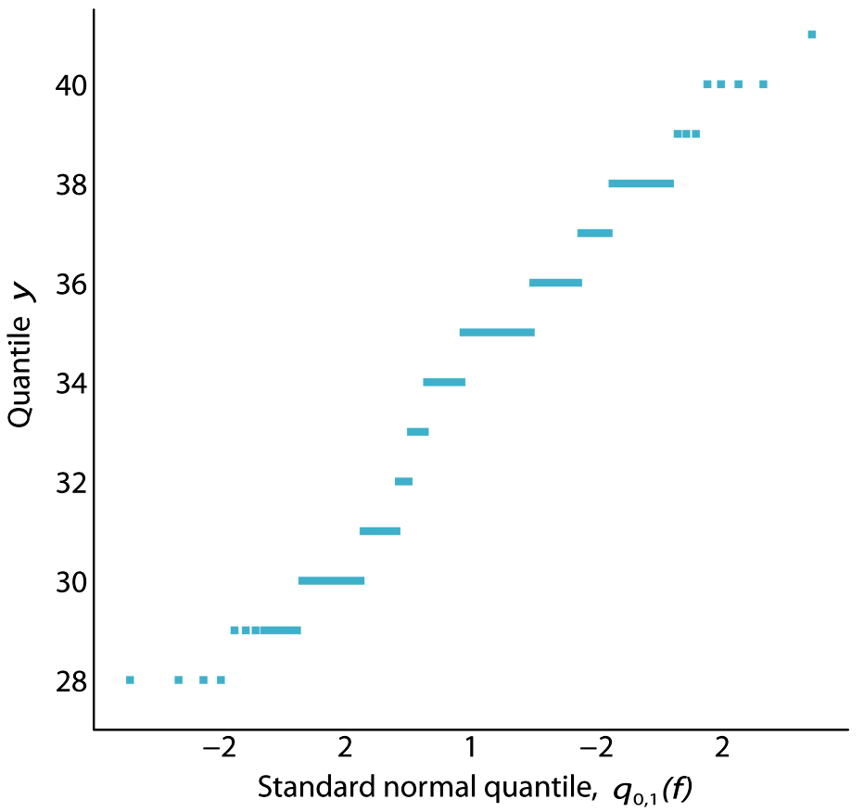
Figure 8.16 Normal quantile-quantile plot for paint data

Slide 42
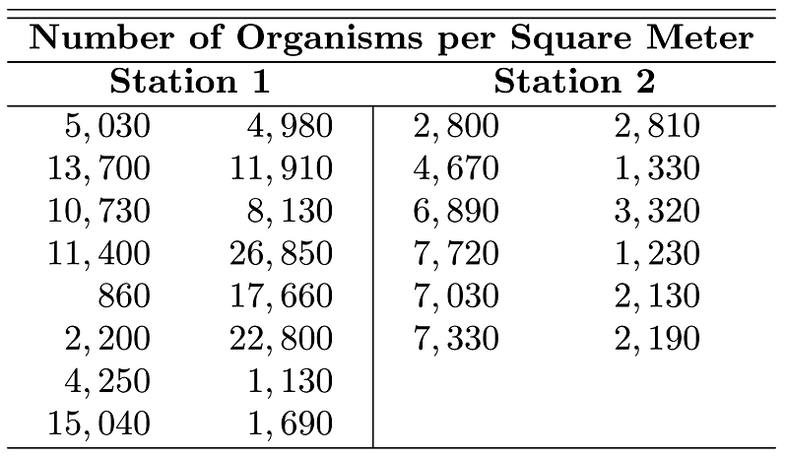
Table 8.1 Data for Example 8.12

Slide 43
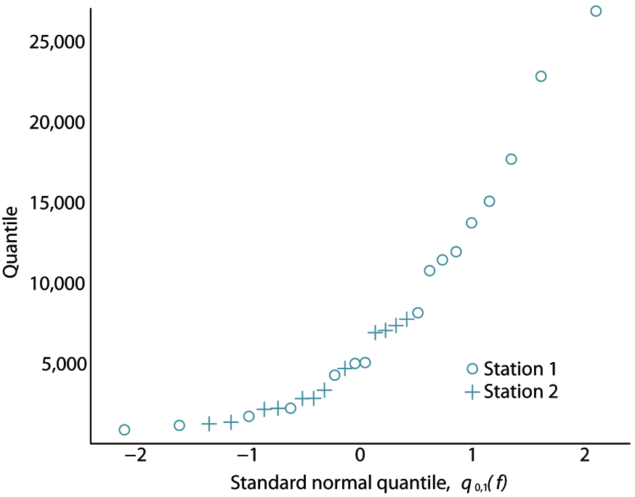
Figure 8.17 Normal quantile-quantile plot for density data of Example 8.12

Slide 44
Section 8.9
Potential Misconceptions and Hazards; Relationship to Material in Other Chapters

